Slide 1


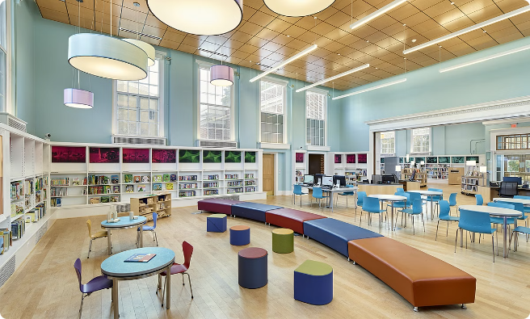

Library Management System: A User-Friendly Solution
Welcome to the Library Management System project! This presentation will introduce you to a user-friendly system designed to streamline library operations and enhance user experience.
Done by:
Faiz Rahman G
Samuvin Jenish S J
Sharvesh L

Slide 2
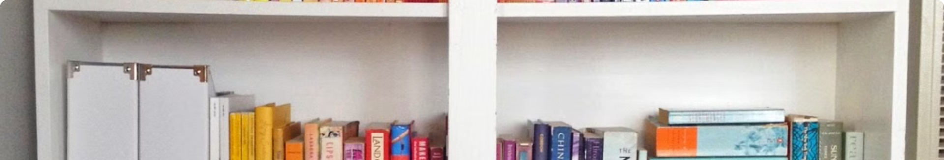
Project Overview
1
Objective
2
Target Audience
The project aims to develop a comprehensive web-based system for managing library operations.
The system is intended for librarians, library staff, and library users.
3
Key Features
4
Technology Stack
The system will include features such as book cataloging, user accounts, checkout and return management, and search functionality.
The project utilizes modern web technologies, including React.js for the front-end, Node.js for the back-end, and MongoDB for database management.

Slide 3
Front-End Development
User Interface (UI)
User Experience (UX)
Development Process
The front-end is built using React.js, a popular JavaScript library for creating interactive user interfaces.
The front-end focuses on providing a seamless and enjoyable user experience for both librarians and library users.
The front-end development follows agile methodologies, with regular iterations and user feedback incorporated.
Responsive design
Clear and concise information display
Component-based architecture
Intuitive navigation
User-friendly search functionality
Easy-to-use controls and forms
Unit testing and code reviews
Continuous integration and deployment
Visual cues and feedback mechanisms

Slide 4

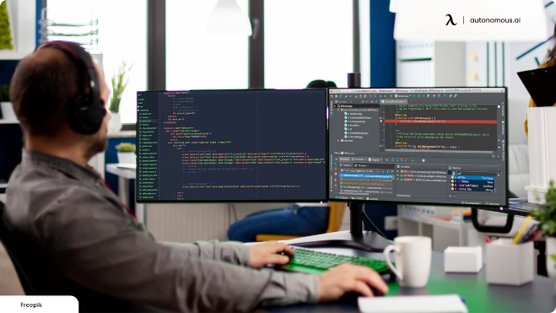
Installation and Setup
1
Prerequisites
Ensure that you have Node.js and npm (Node Package Manager) installed on your system.
2
Cloning the Repository
Clone the project repository from GitHub using the provided URL.
3
Installing Dependencies
Navigate to the project directory and run the following command to install all necessary dependencies.
4
Starting the Development Server
Once dependencies are installed, run the development server to start the application.

Slide 5


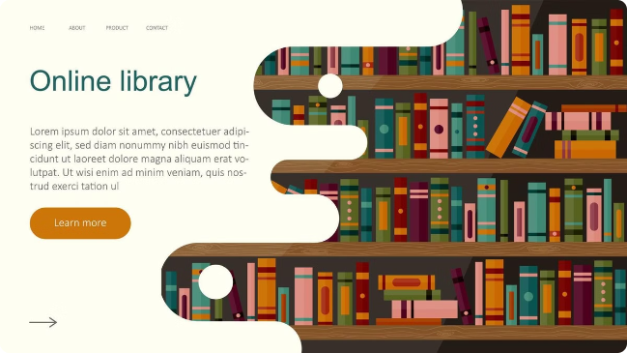


Running the Application
Access the Application
The application will be running on a local server, typically at `http://localhost:3000`.
User Authentication
You can log in using the provided credentials or create a new user account.
Exploring the Features
Browse the different sections of the application, such as book catalog, user profiles, and checkout history.

Slide 6


Key Features and Functionalities
Feature
Description
Book Cataloging
Add, edit, and delete book entries with details like title, author, ISBN, and availability.
User Accounts
Create and manage user profiles with information such as name, contact details, and borrowing history.
Checkout and Return
Allow users to checkout and return books, tracking due dates and late fees.
Search Functionality
Enable users to search for books by title, author, subject, or keyword.
Reporting
Generate reports on library usage, book circulation, and overdue items.

Slide 7


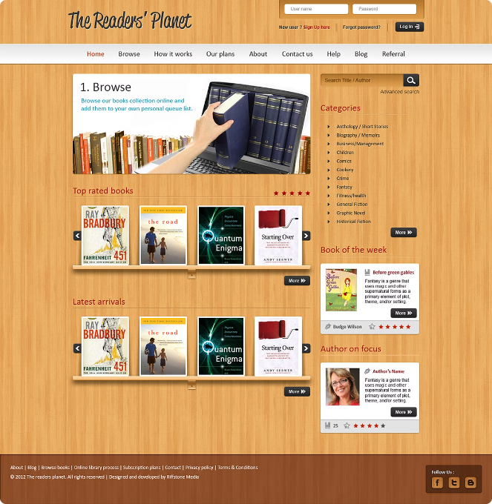



User Interface Design
User-Centric Approach
The UI is designed with the user in mind, prioritizing ease of use and accessibility.
Search Functionality
A powerful search feature allows users to quickly and easily find the books they need.
Book Details
Comprehensive book details are provided, including cover image, summary, and availability status.
Customization Options
Users can personalize their experience with settings such as preferred language and display options.

Slide 8


Conclusion and Next Steps
The Library Management System project is a successful implementation of a user-friendly and efficient library management solution. The next steps involve ongoing maintenance, updates, and improvements based on user feedback and emerging technologies.

